Slide 1
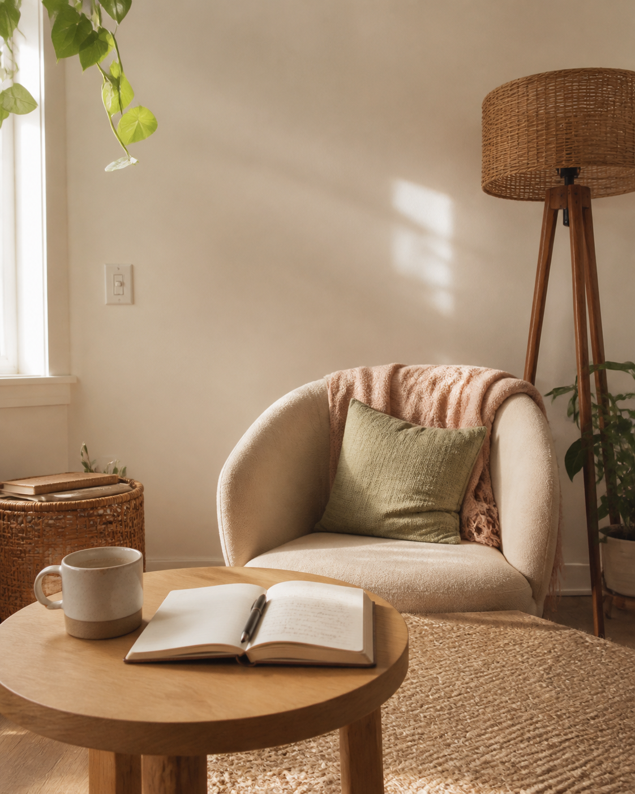
WEEKEND PHOTO DIARY · 01
a weekend
in soft focus
a few small things i want to remember from lately
camera roll notes → august
01

Slide 2
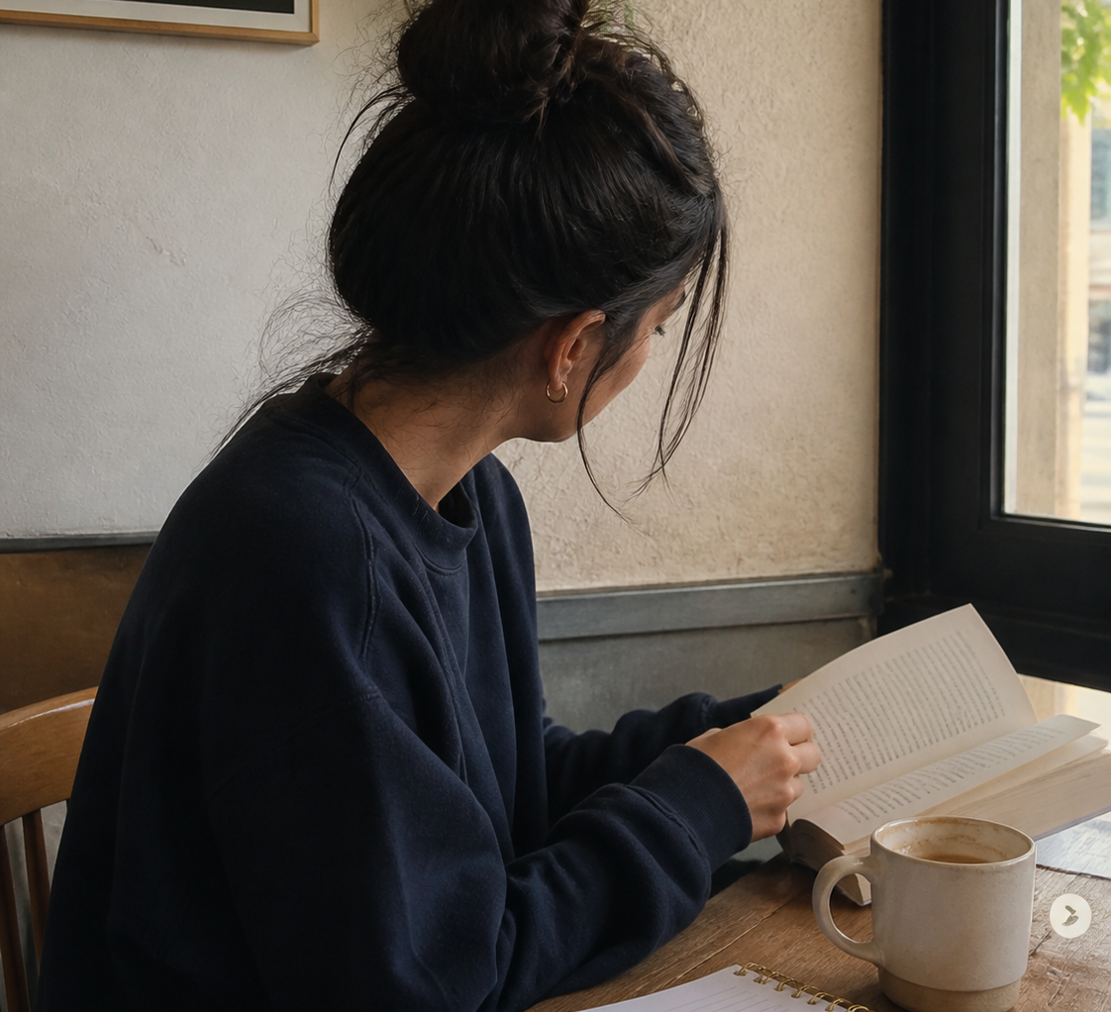
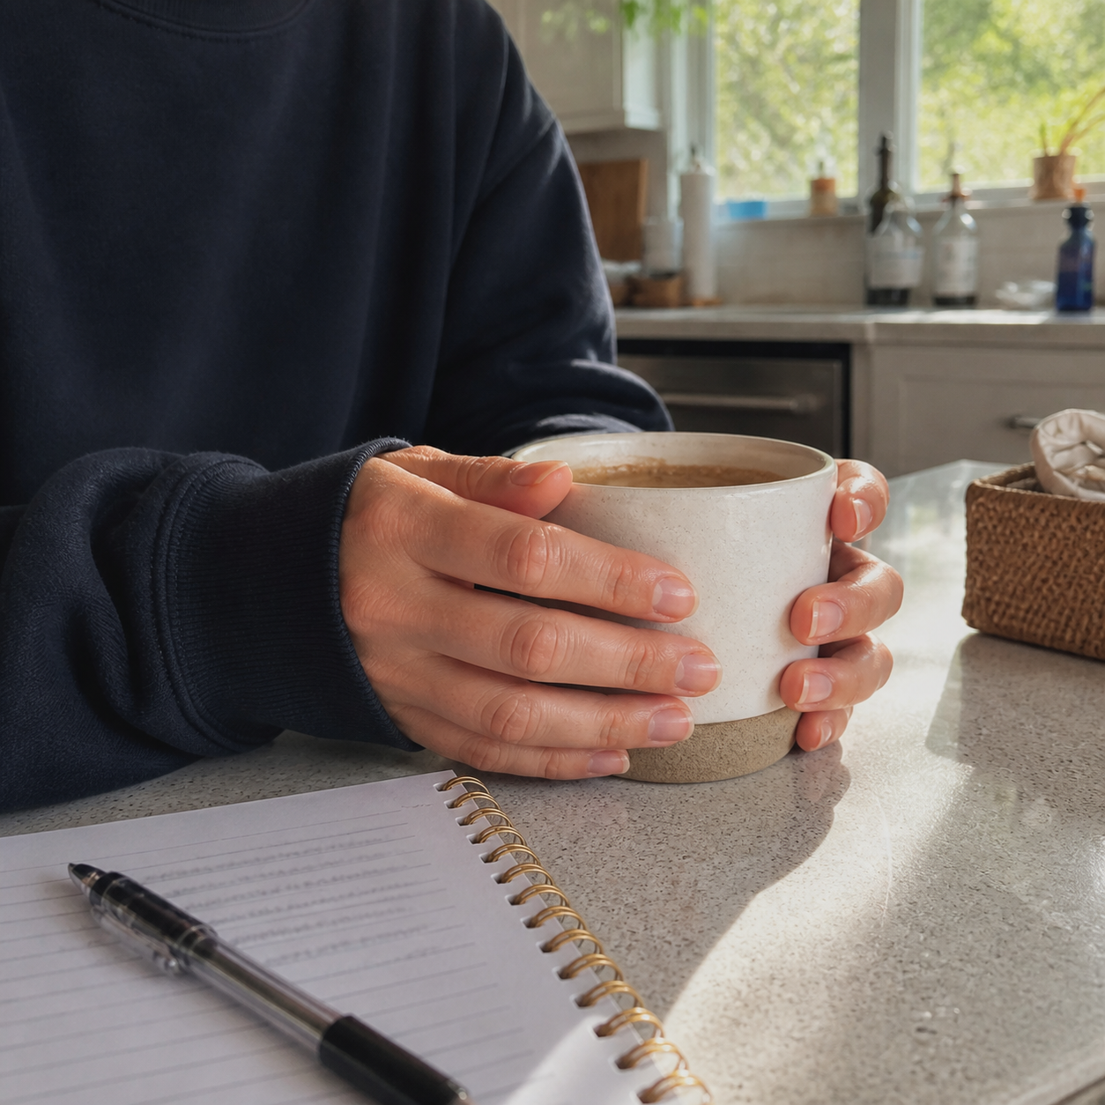

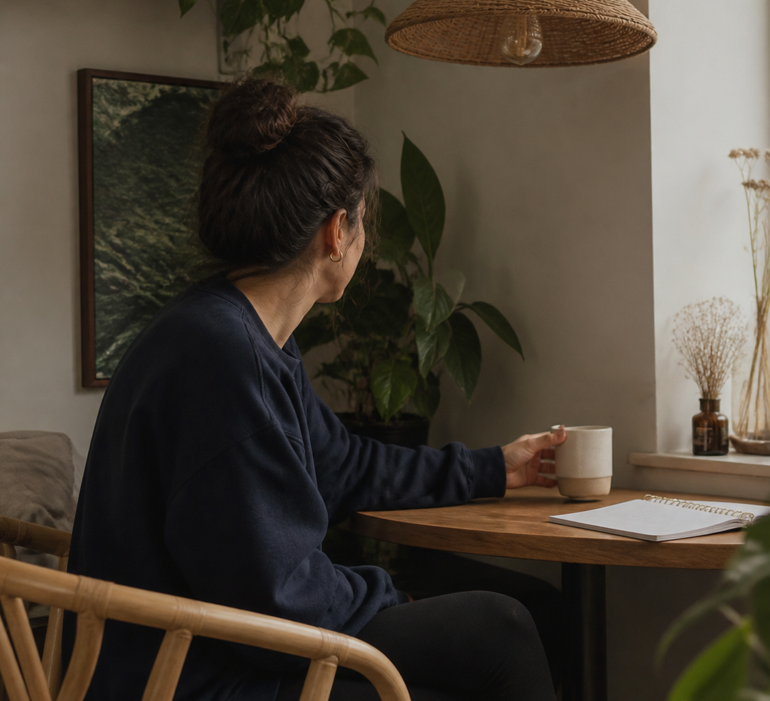
THE LITTLE THINGS · 02
more of this
please
02

Slide 3
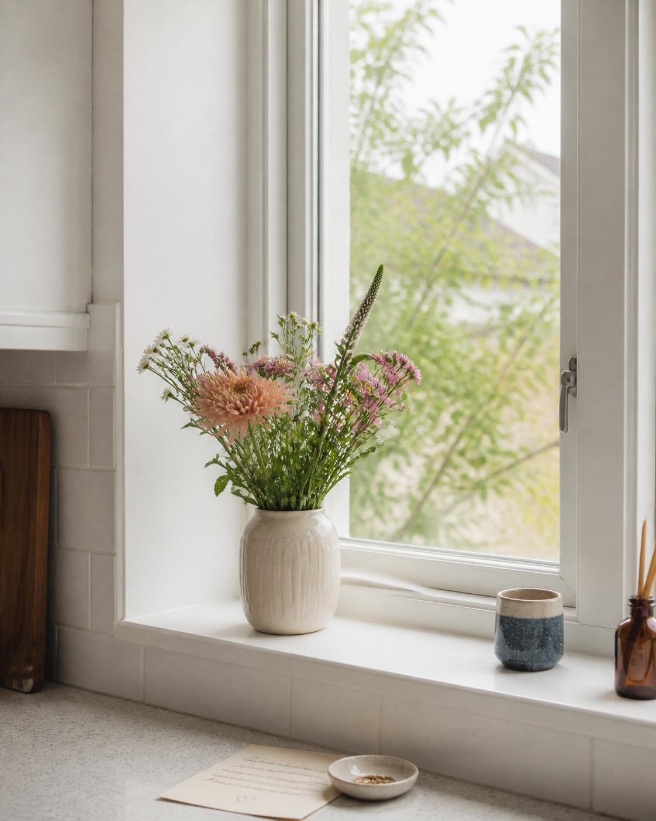
CURRENTLY · 03
weekend
favourites
→
slow pages
→
coffee walks
→
fresh flowers
→
the long way home
tiny wins from this week ✦
03

Slide 4

UNTIL NEXT TIME · 04
save the
feeling
i want more weekends that make the week feel a little lighter
for a slower day ♡
04

